Slide 1

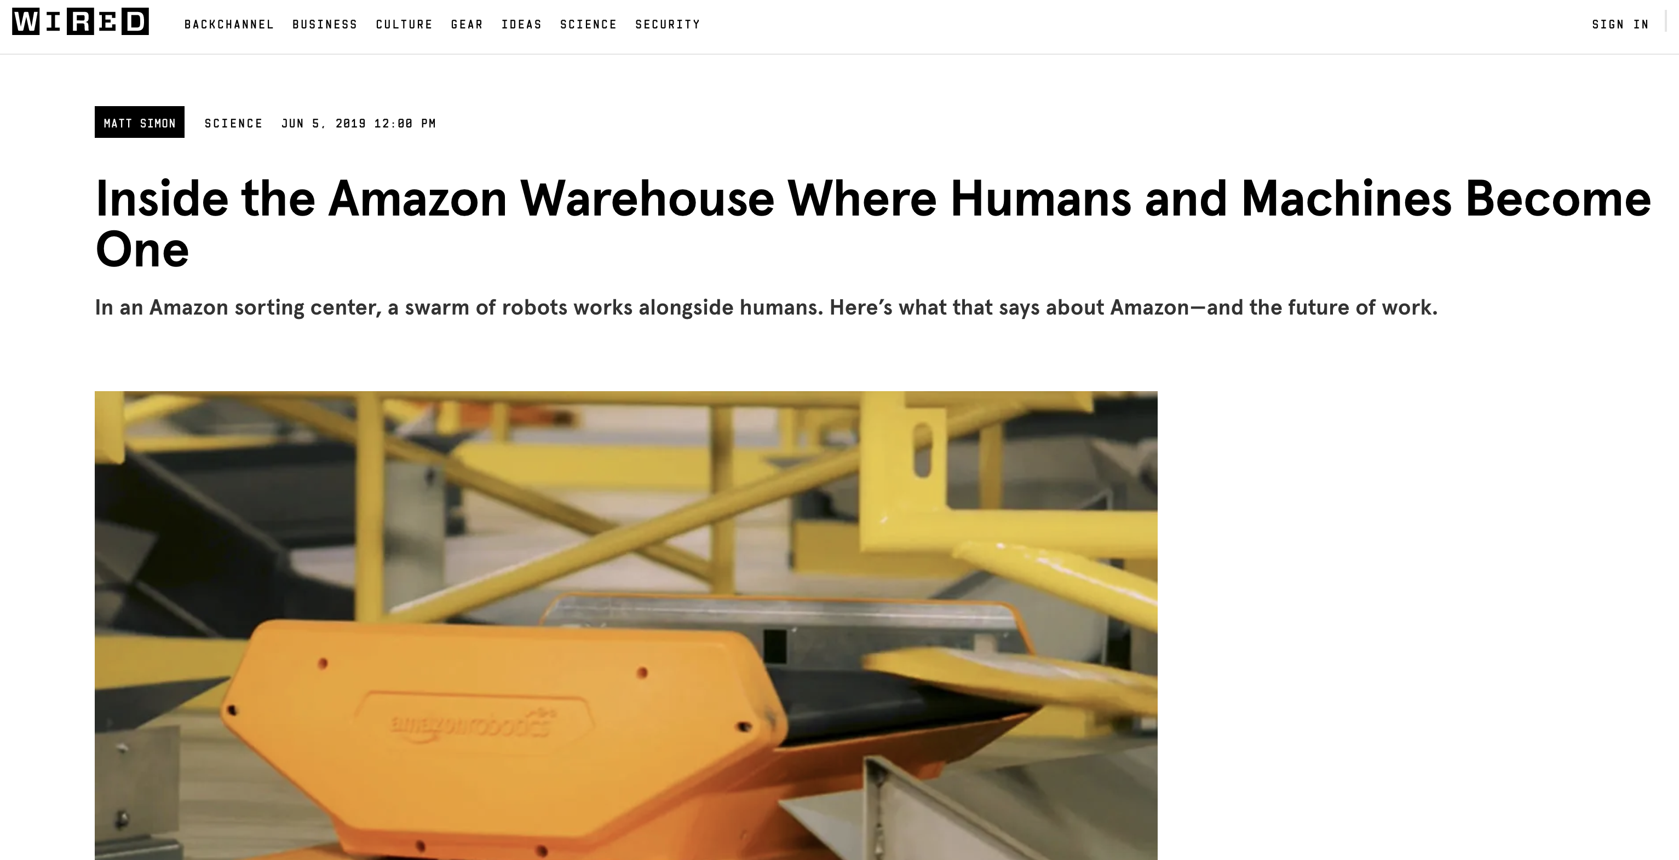
Nhat (Nick) Pham
Lecture 1: “Things of the Internet”
(With grateful thanks to Andrew Markham)
https://www.wired.com/story/amazon-warehouse-robots/

Slide 2
Introduction
Lecturer
Nhat (Nick) Pham. (nhat.pham@cs.ox.ac.uk)
Course website
https://www.nhatpham.info/teaching/aims-iot-2023
(Linked to Canvas)
Please check it regular for updates!
Teaching Assistants
Lab 1: Minh Tran. (minh.tran@ndcn.ox.ac.uk)
Lab 2: An Nguyen. (an.nguyen@cs.ox.ac.uk)
Lab 3: Tien Ly. (kim.ly@st-hughs.ox.ac.uk)
Lab assessments.
Please send your completed (individually) lab results (PDF) to my email by Monday.
Notes:
So what is the Internet of Things? What is this module going to be all about?

Slide 3
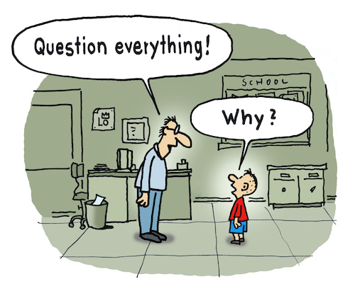

Introduction
www.toonpool.com
www.vecteezy.com
What is the IoT?
What will we cover in this module?
Notes:
So what is the Internet of Things? What is this module going to be all about?

Slide 4
Origins
The Internet of Things (IoT) - ubiquitous sensors connecting the physical world to the Internet
Coined by UK scientist Kevin Ashton in 1999
An umbrella term that means everything from embedded sensing through to data analytics
Notes:
Well, the name Internet of Things basically refers to ubiquitous sensors connecting the physical world to the Internet. And it was originally coined by a UK scientist called Kevin Ashton in 1999 as an umbrella term that means everything from embedded sensing through to data analytics.

Slide 5
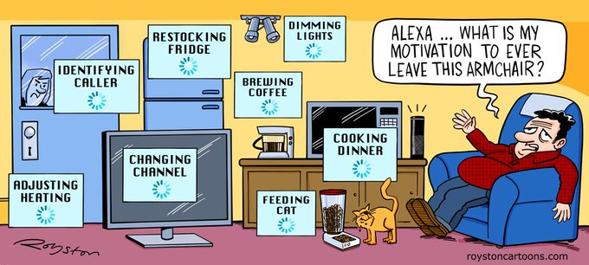
Smart…Everything?
Smart Home
Smart City
Smart Factory
Smart Body
Smart Farm
Smart Grid
Smart *
Notes:
And on some level, it was a bit of a marketing phrase even then, and of course it’s now led to lots of follow-on marketing phrases, mostly involving the word ‘smart’. So now we have smart homes, smart cities, smart factories, and so on, because smart things are commonly thought of as being de facto good, and companies thus think they can sell you more of them.

Slide 6
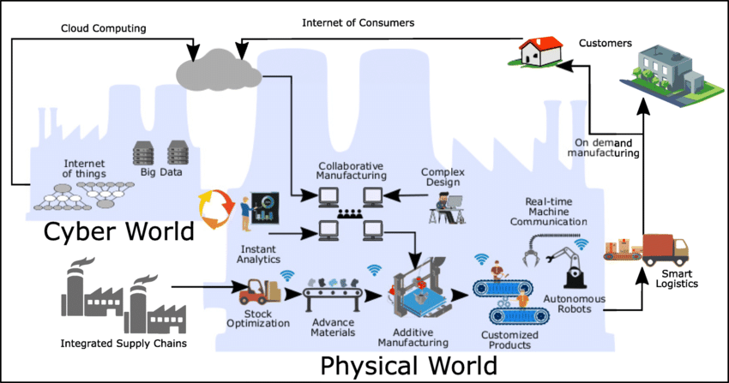
Is it just a marketing exercise?
Cyber-Physical Systems
Industry 4.0
M2M (machine-to-machine)
V2V (vehicle-to-vehicle)
V2X (vehicle-to-anything)
Wireless Sensor Networks
[1]
[1] Balderas, David, et al. "Empowering Digital Twin for Industry 4.0 using metaheuristic optimization algorithms: case study PCB drilling optimization." The International Journal of Advanced Manufacturing Technology 113 (2021)
Notes:
So, has it all just been a marketing exercise? Or is there something real underlying it?
Well, to be honest, there have been a lot of real improvements in technology over the last twenty years. So for example, enabling your toaster to access the internet might not be all that useful, but it is potentially very useful to be able to do things like control robots over the internet, and that’s now very much a thing. And similarly, it’s potentially very useful for autonomous cars to be able to communicate via the internet, without needing to establish direct connections between them.
So even if we think all of the hype and the buzzwords are a bit ridiculous, and personally I do, it’s still worth paying careful attention to the real technological advances being made under cover of the jargon.

Slide 7
Can we define the IoT?
It is not particularly easy
IEEE has an 86-page document which tries to do just this¹
¹https://iot.ieee.org/definition.html
Notes:
Ok, so let’s say we’re going to invest a bit of effort in understanding what IoT’s all about. So can we at least define it?
Well unfortunately, because it’s a marketing thing, it’s not actually all that easy to define in an objective way. And so lots of people have tried to do it, and all come up with slightly different definitions.
So for example, the IEEE tried it, and ended up spending 86 pages on it. And we’re definitely not going to read that. So what about something a bit shorter?

Slide 8
An IoT Definition
A world where physical objects are seamlessly inte- grated into the information network, and where the physical objects can become active participants in busi- ness processes.²
²Weber et al. 2010
Notes:
Well, here’s a Weber et al. definition from 2010. So they define it as “a world where physical objects are seamlessly integrated into the information network, and where the physical objects can become active participants in business processes”. So that seems ok maybe, although perhaps a little too enterprise-y for some people’s tastes.

Slide 9
Another IoT Definition
System where the Internet is connected to the physical world via ubiquitous sensors.³
³Oasis 2014
Notes:
So here’s an even shorter one from Oasis 2014, where they described IoT as being a “system where the Internet is connected to the physical world via ubiquitous sensors”. Which again, seems fair enough, but perhaps loses some emphasis on being able to control physical objects over the internet.

Slide 10
Another IoT Definition
The Internet of Things represents a vision in which the Internet extends into the real world embracing everyday objects. Physical items are no longer disconnected from the virtual world, but can be controlled remotely and can act as physical access points to Internet services. An Internet of Things makes computing truly ubiquitous.⁴
⁴Mattern et al. 2010
Notes:
So if we don’t like that one either, here’s a longer definition by Mattern et al. 2010 to consider. So in their view, “The Internet of Things represents a vision in which the Internet extends into the real world embracing everyday objects. Physical items are no longer disconnected from the virtual world, but can be controlled remotely and can act as physical access points to Internet services. An Internet of Things makes computing truly ubiquitous.”
So that one seems kind of ok, if a bit long.

Slide 11
Another IoT Definition
The expression Internet of Things is wider than a single concept or technology. It is rather a new paradigm that involves a wide set of technologies, applications and vi- sions.⁵
⁵Giusto et al. 2010
Notes:
And then there’s one final one from Giusto et al. 2010, where they say: “The expression Internet of Things is wider than a single concept or technology. It is rather a new paradigm that involves a wide set of technologies, applications and visions.”
So to be honest, I’m not too convinced by this one, because it seems to try to dodge the question by being vague and overly general, but maybe you can make your own mind up!

Slide 12
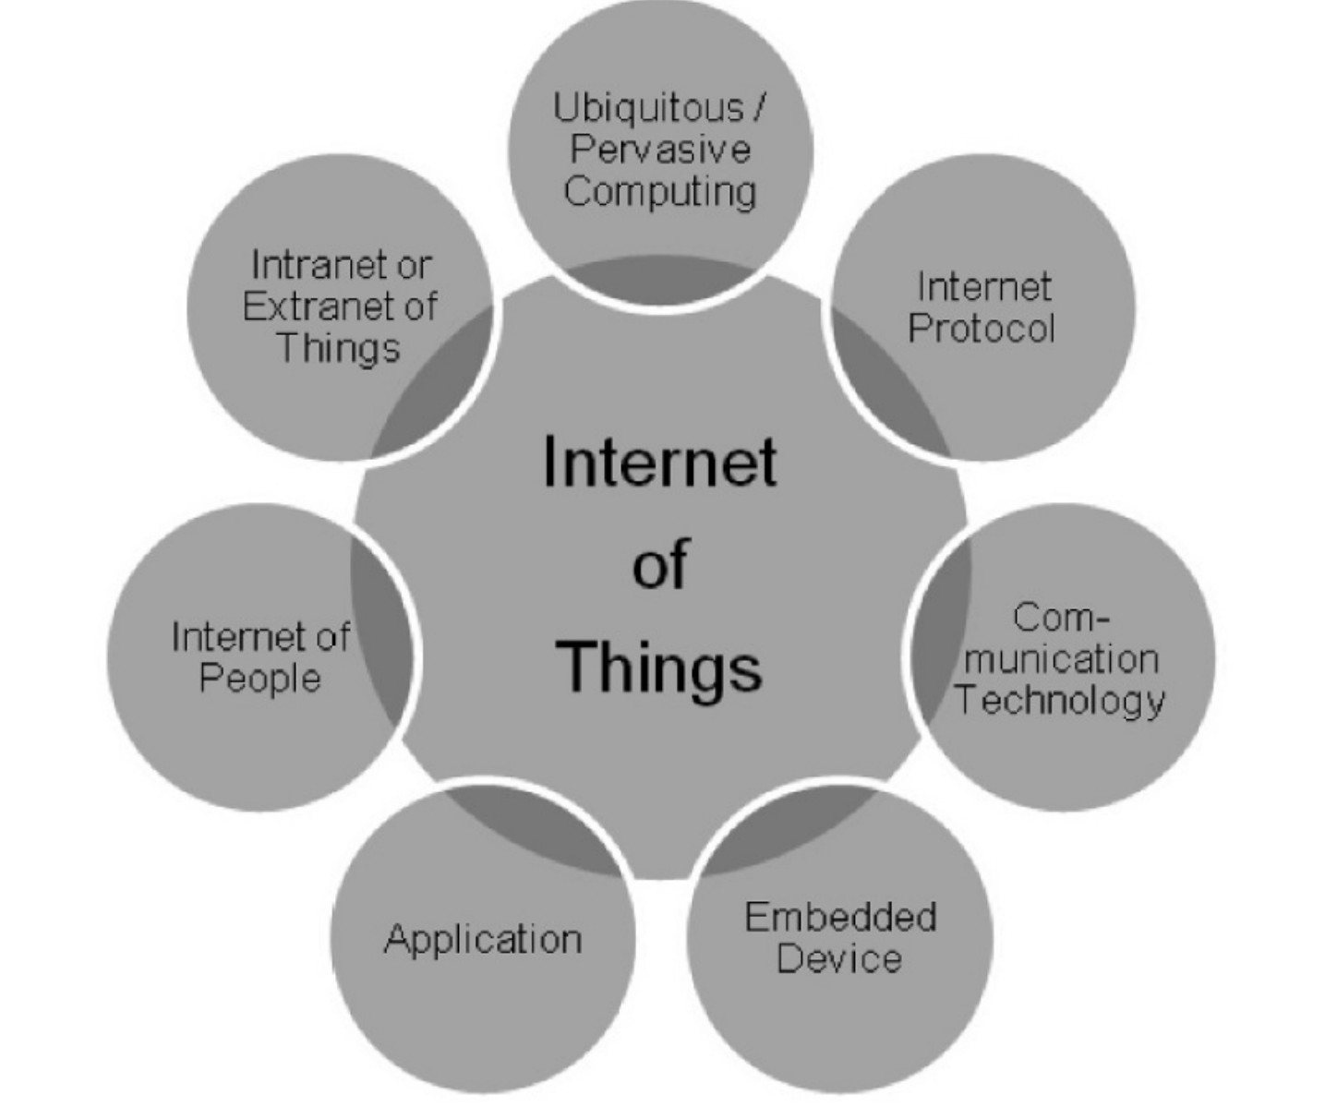
IoT Intersections⁶
⁶Architecting the IoT, Uckelmann et al. 2011
Notes:
In any case, definitions aside, it seems it’s at least possible to draw a diagram of what IoT is, and which other areas it touches upon, and you can see that in this slide.

Slide 13
Key ingredients of the IoT
Perception/Sensing
Computation
Communication
Actuation
Localisation
Integration
Notes:
So for our purposes in this course, what we’re really going to be talking about are the following things, all under the general heading of IoT.
So essentially, we’re going to be looking at various aspects of perception and sensing, computation, communication, actuation, localization and integration.

Slide 14
What then is a thing?
In the vision of IoT, things are very various such as computers, sensors, people, actuators, refrigerators, TVs, vehicles, mobile phones, clothes, food, medicines, books, etc. These things are classified as three scopes: people, machine (for example, sensor, actuator, etc.) and information (for example, clothes, food, medicine, books, etc.)⁸
⁸IETF
Notes:
So that’s all well and good, but the name IoT means Internet of Things, and despite all of our best efforts, we still haven’t really pinned down what a “thing” is in this context. So what do we mean by it?
Well, as the IETF puts it, “In the vision of IoT, things are very various such as computers, sensors, people, actuators, refrigerators, TVs, vehicles, mobile phones, clothes, food, medicines, books, etc. These things are classified as three scopes: people, machine (for example, sensor, actuator, etc.) and information (for example, clothes, food, medicine, books, etc.)”.
So as you can see, the concept of a thing has quite a broad scope.

Slide 15
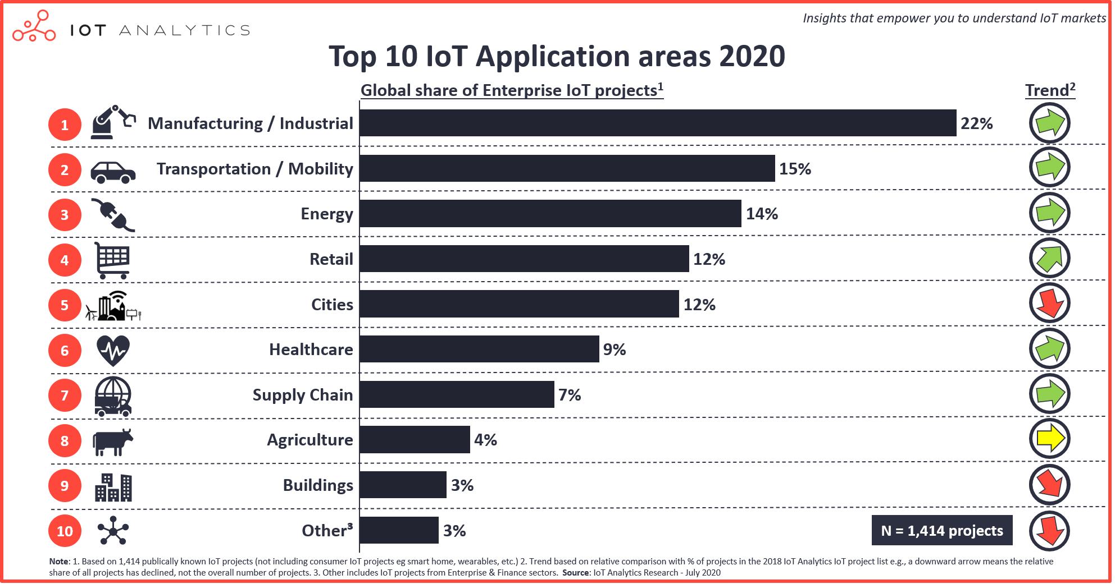
IoT Share¹¹
¹¹IoT Analytics report
Notes:
So where is most of this activity taking place? Well, there’s a huge amount going on in the Americas, Europe and the Asia Pacific region. And there’s also some well-focused activity in the Middle East and Africa, especially in the Connected Industry, Smart City and Connected Car segments. Indeed, worldwide, the top four segments are Connected Industry, Smart City, Smart Energy and Connected Car, with the biggest growth segments right now being Smart City, Connected Building, Smart Agriculture and Smart Retail.

Slide 16
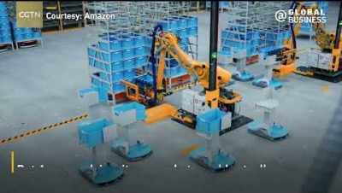
Amazon robotic warehouse

Slide 17
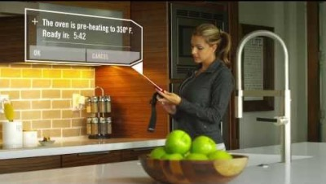
Home automation
Connected Devices Laboratory, Brigham Young University, Utah, USA.

Slide 18
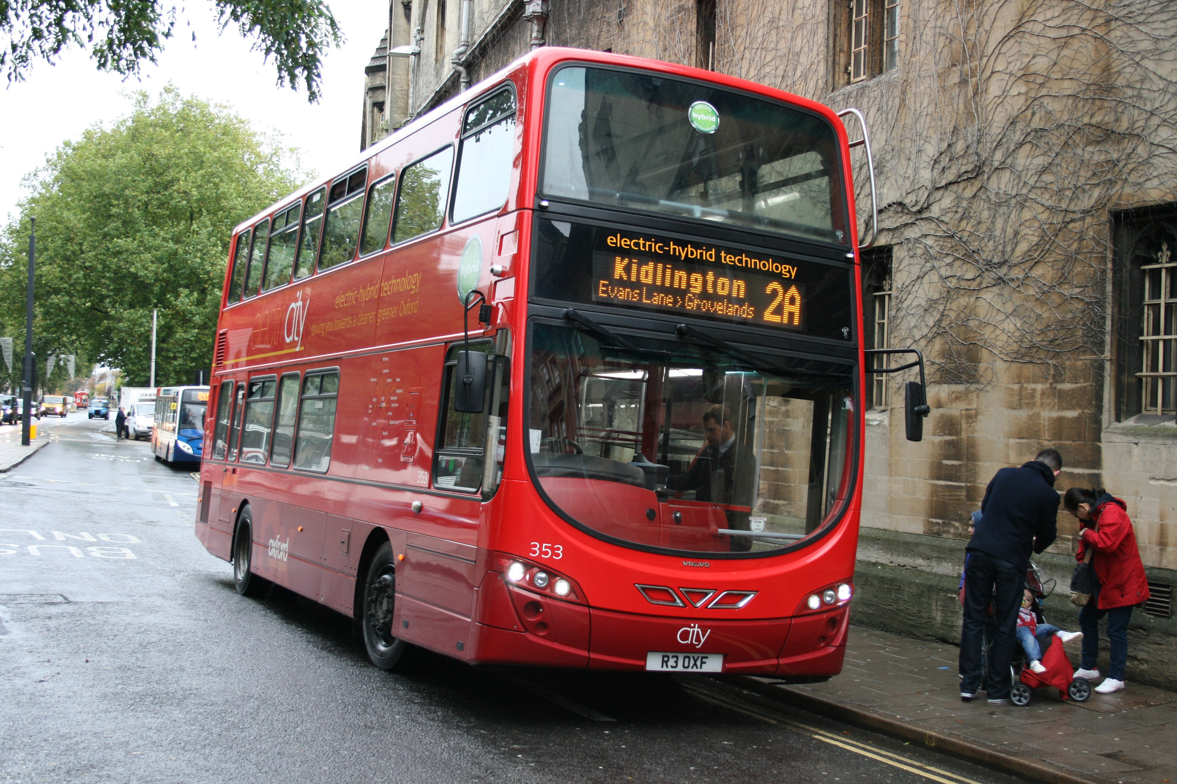
Smart buses
Notes:
Ok, so what about smart buses? Well, you’ve probably seen these around Oxford actually, where they’ve now got smart bus stops that can tell you pretty accurately when your bus is going to arrive. And honestly, this is one of the better uses of IoT technology, because it’s used by everyone, not just techies, and it can help them judge whether to wait for the bus or choose another option, which can be a real time-saver.
So smart buses seem genuinely pretty good, particularly in comparison to what went before, where you’d be hanging around for long periods wondering if the bus was ever going to turn up or not.

Slide 19
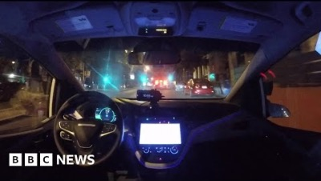
Autonomous vehicles
BBC News

Slide 20
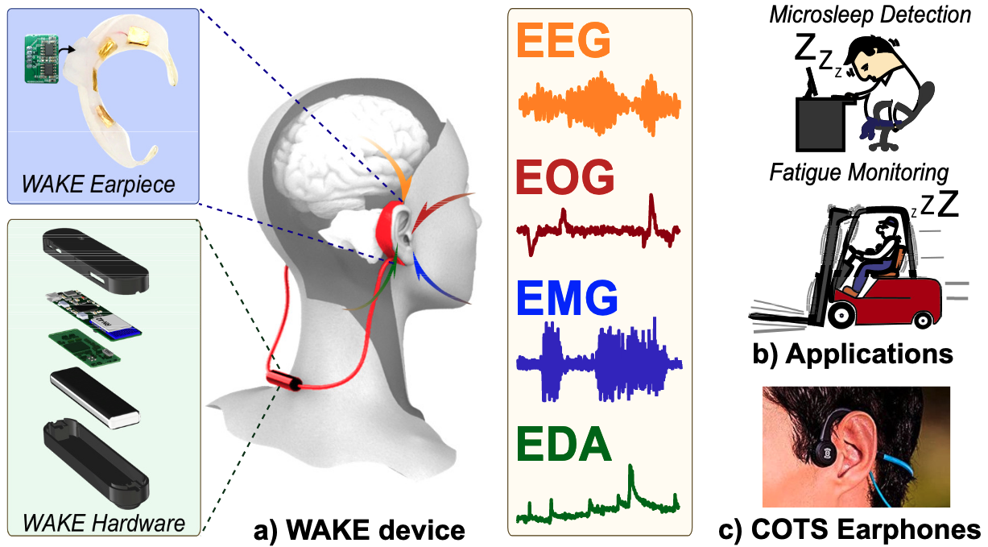

Smart wearables
Pham, Nhat, et al. "Detection of Microsleep Events with a Behind-the-ear Wearable System." IEEE Transactions on Mobile Computing (2021).

Slide 21
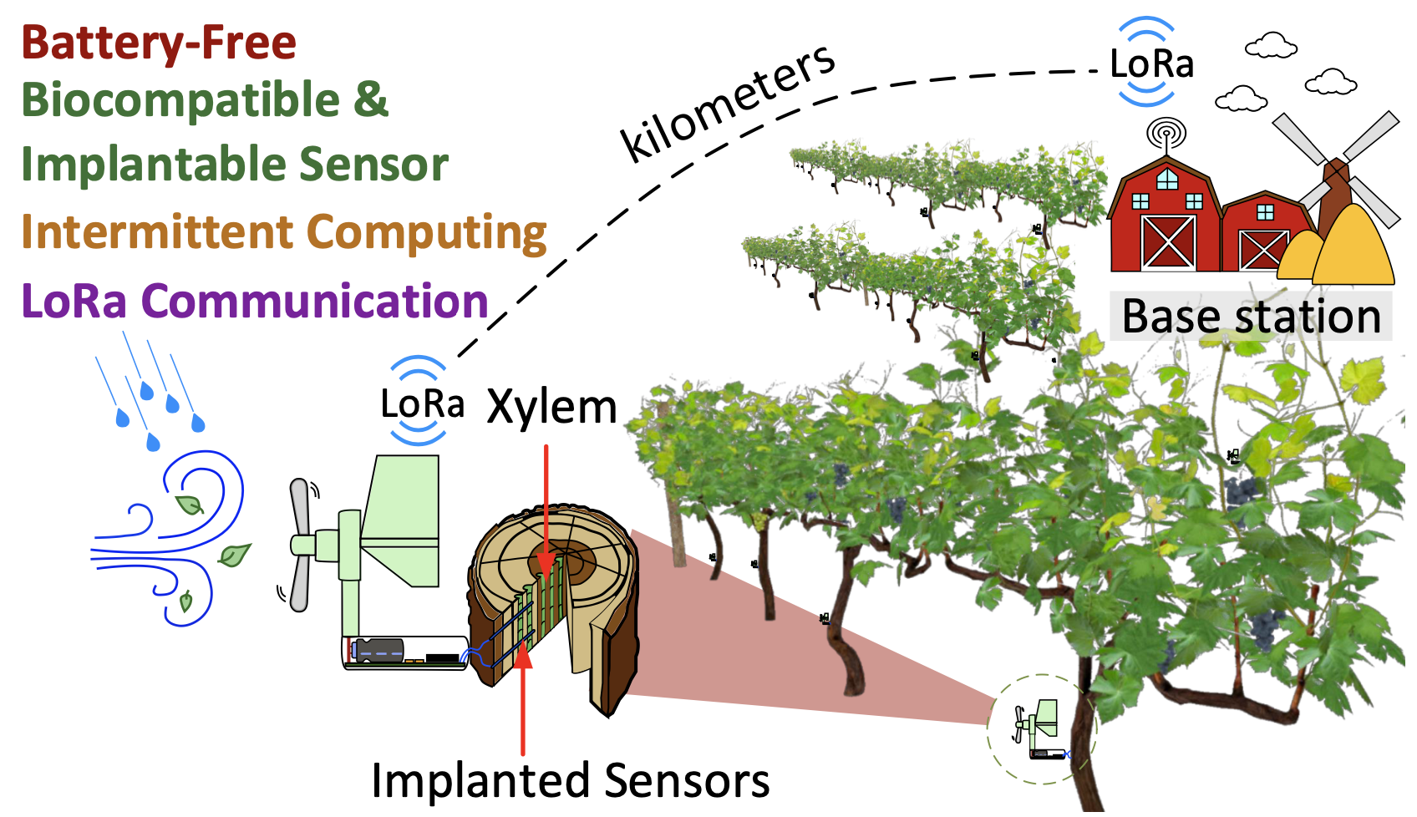
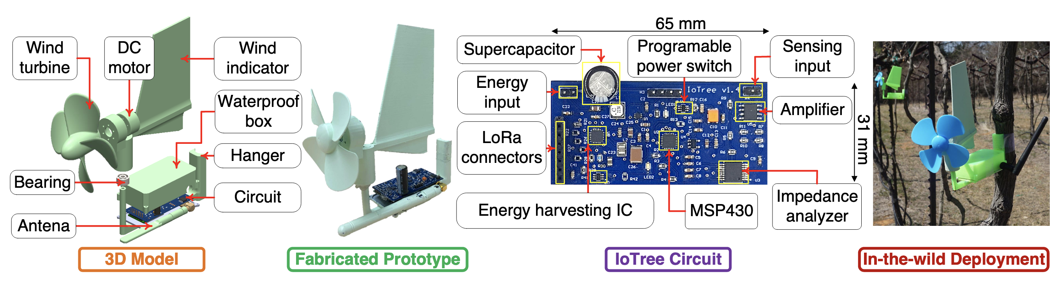
Smart agriculture
Dang, Tuan, et al. "ioTree: a battery-free wearable system with biocompatible sensors for continuous tree health monitoring."
Proceedings of the 28th Annual International Conference on Mobile Computing And Networking. 2022.

Slide 22
Broad course organization
Yes:
Anatomy of things
Localization
Routing and Networking
ROS
Navigation and Positioning
Wearable Computing
On-chip intelligence
No:
Physical layer and the realities of electromagnetic propagation
Medium Access
Information Processing
Securing the IoT
Vendor-specific solutions and architecture
The broader internet and the cloud: instead, we focus on the things themselves
Notes:
Ok, so we’ve looked at a few things that IoT might be useful for, but what aspects of it are we going to cover in this course?
Well, this is a relatively short course, so we’re not going to be able to cover absolutely everything. Instead, we’re going to focus on aspects such as the anatomy of things, how to work out where things are, and how to establish ad-hoc networks between them and perform routing.
But there’s obviously a lot more to IoT than just that, so if you’re interested, you might like to explore some of the topics shown on the right of this slide on your own.

Slide 23
Anatomy of a Thing
Notes:
Ok, so without further ado, let’s now talk a bit about the anatomy of a thing.

Slide 24
Overview
What makes up a thing?
How does it process information?
Where does it get power from?
Notes:
So this section is about topics such as what makes up a thing, how it processes information, and where it gets its power from.

Slide 25
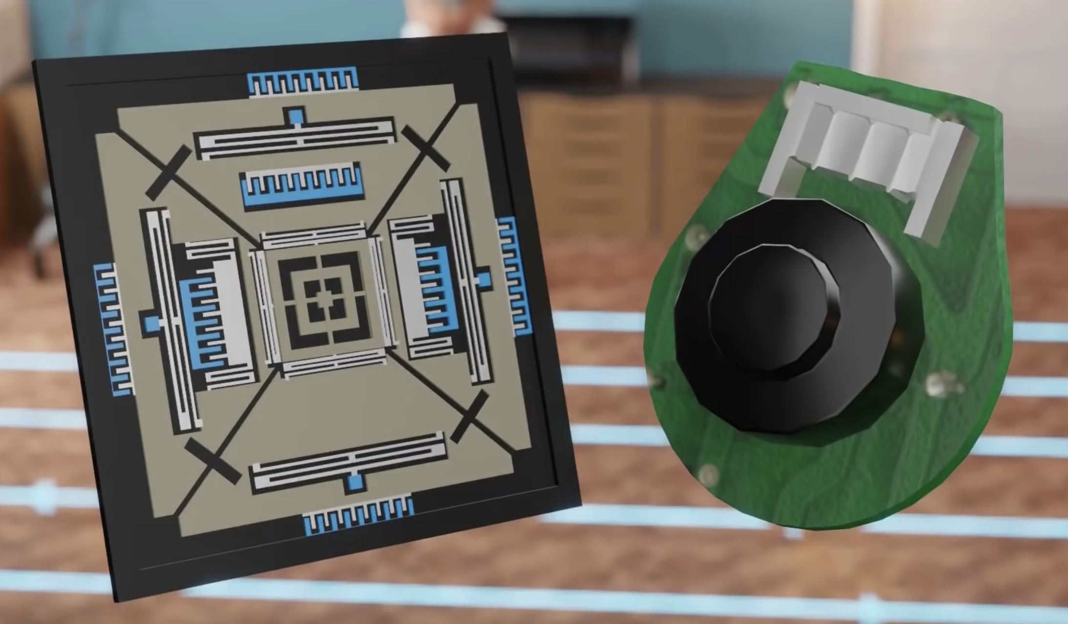
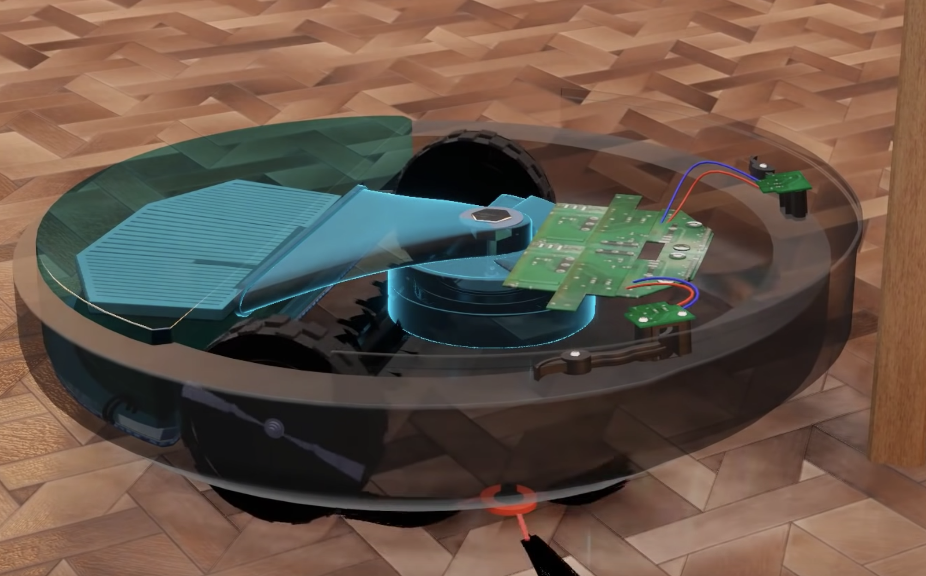
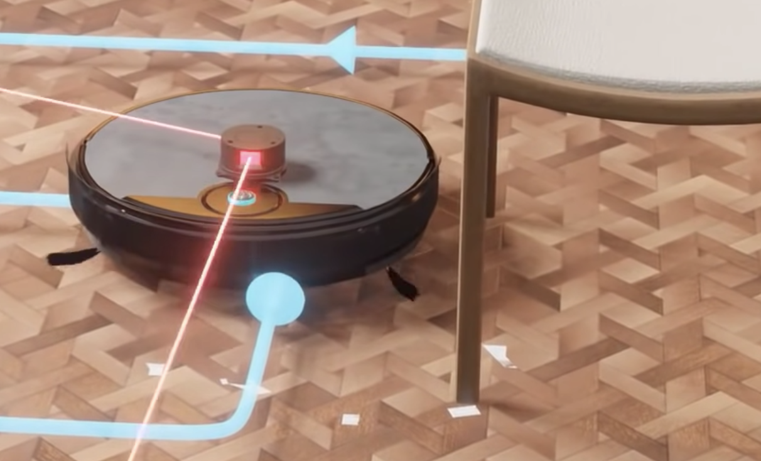
Things
Gyroscope &
Wheel encoder
Things combine:
Computation
Communication
Sensing
Actuation
Examples
Vacuum robots.
Microcontroller
Vacuum
Optical sensors
WiFi communication
LIDAR & Camera
Wheels
Side brushes
LESICS
Notes:
So at a high-level, things can be seen as combining four aspects: computation, communication, sensing and actuation.
That is, things typically need to be able to run code, communicate with other things, and sense and/or interact with their environment.
And if you think that sounds a bit like a robot, you’d be right, although robotics tends to have more of a focus on physically interacting with the real world, and “robot” as a term is generally used to refer to things that are much higher-level than a typical IoT thing.

Slide 26
Anatomy of a Thing Computation
Notes:
So let’s dig a little deeper into the computation part of that.

Slide 27
Highly heterogeneous
Available computational power varies widely
Strongest correlation is with availability of energy
Notes:
So the computational power available to different types of IoT thing varies widely in practice, and is most closely correlated with their energy usage.
So in other words, things that can use a lot of energy, for example because they’re plugged into the mains electricity supply, can perform quite heavy computations, whereas mobile things that are running on small batteries are necessarily more limited in the computations that they can perform.

Slide 28
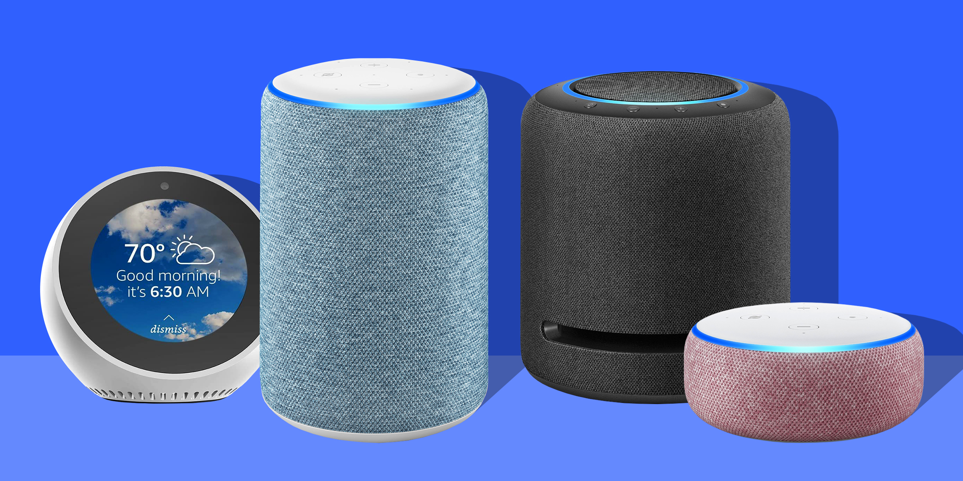
High-end
Single-board computer (in the PC sense)
Raspberry Pi/Beaglebone or equivalent
Typical power consumption in the order of a few Watts
Run Linux or similar operating systems
‘Consumer’ IoT e.g. Amazon Echo
Notes:
So in this context, a high-end device might consist of something like a single-board computer (in the PC sense). So for example, this might be something like a Raspberry Pi, a Beaglebone, or the equivalent. And the typical power consumption of such devices is in the order of a few Watts, which is sufficient to allow them to run Linux or similar operating systems. And a lot of consumer IoT devices operate at this level, so for example this might include things such as the Amazon Echo.

Slide 29
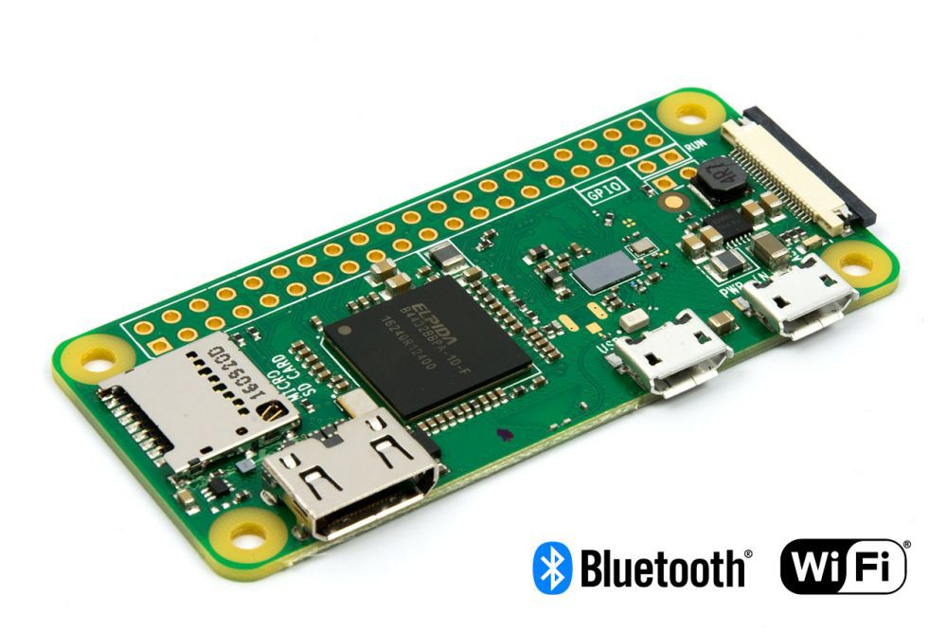
High-end: RPi Zero W
1GHz, single-core CPU
512Mb RAM
WiFi/Bluetooth
1.1 W power consumption
£10
Notes:
And so here’s an example of such a device, namely a Raspberry Pi Zero W. And this one has a 1GHz, single-core CPU, 512Mb of RAM, and WiFi and Bluetooth connectivity. And it consumes roughly 1.1W of power, and can be yours for around £10.

Slide 30
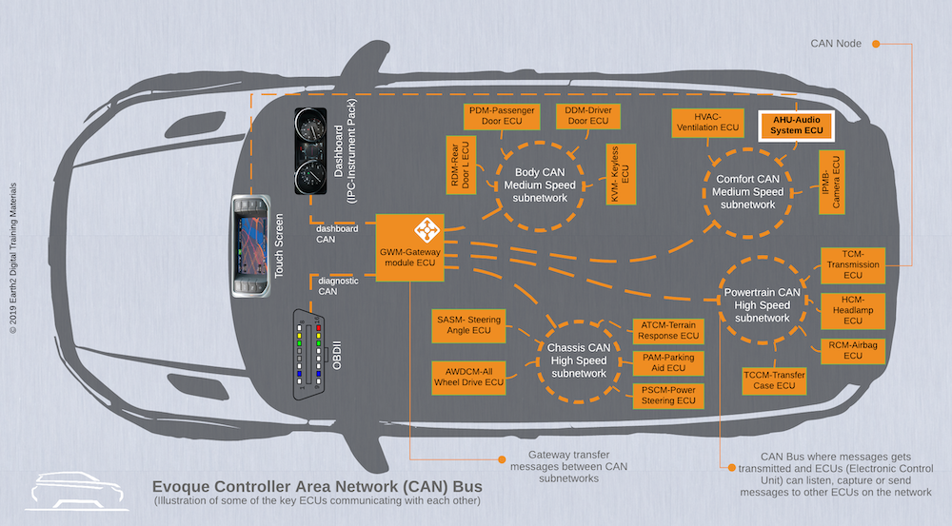
Mid-range
More towards an ‘embedded’ platform
Typical power consumption in hundreds of mW
Run ucLinux, freeRTOS or similar
Industrial motor-control, HVAC systems
Notes:
And then at a slightly lower level, you have the mid-range devices, which are starting to head more towards being an “embedded” platform. So the typical power consumption of these devices is more in the range of hundreds of milliwatts, which is not enough to enable them to run full Linux. So you’ll usually find these devices running things like ucLinux, freeRTOS or similar. And these devices have various niches, including industrial motor-control, and heating, ventilation and air conditioning systems.

Slide 31
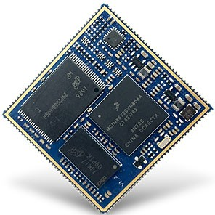
Mid-range: iMX6-SOM
500 MHz, single-core ARM-Cortex A7 CPU
256 Mb DDRAM
250 mW power consumption
£18
Notes:
And so here’s an example of a mid-range device, in this case an iMX6-SOM, which has a 500MHz, single-core ARM-Cortex A7 CPU and 256 Mb of DDRAM. And this has a power consumption of around 250mW, and will set you back a mere £18.

Slide 32
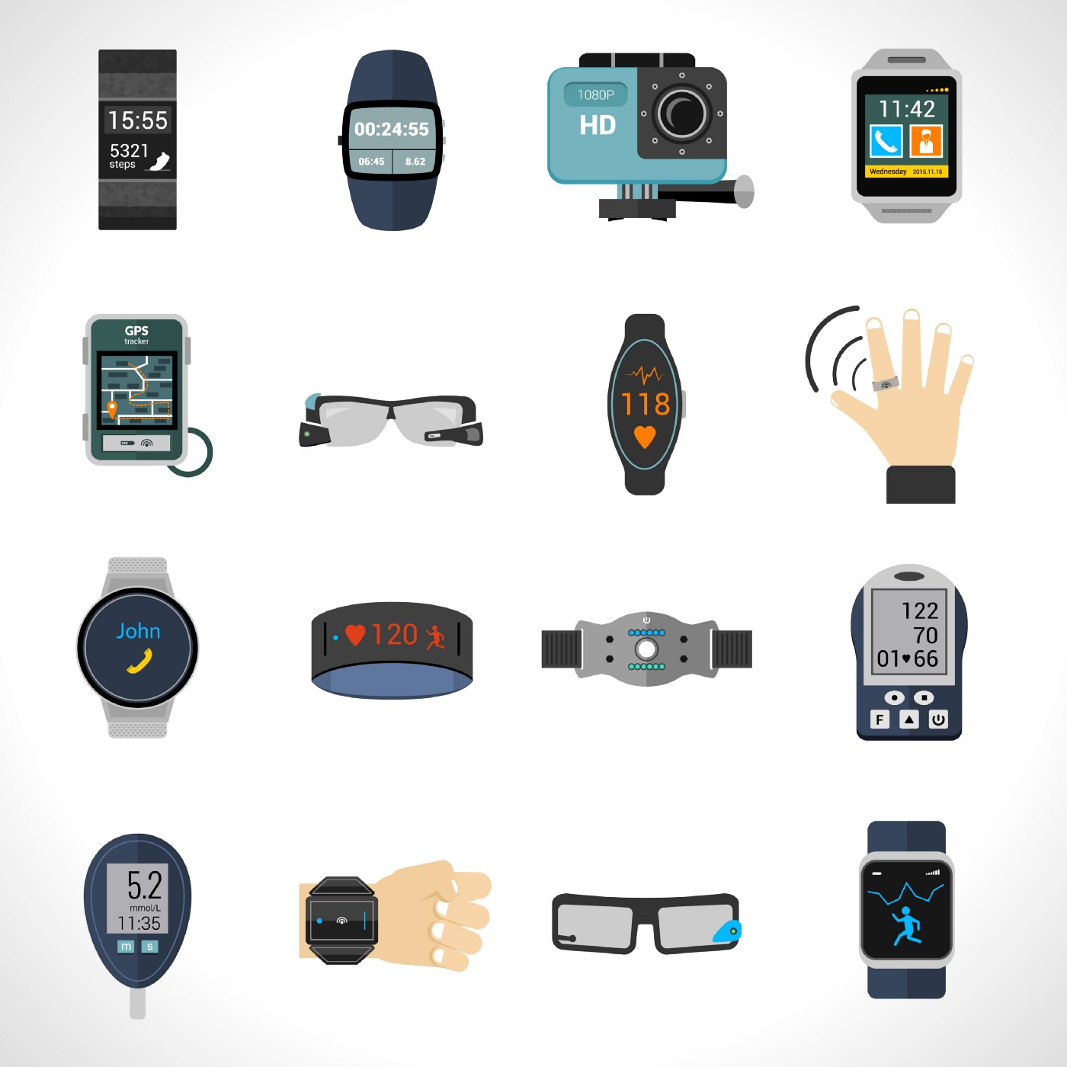
Low-end
Battery-powered end devices
Emphasis on highly optimized design
Typical power consumption in few mW
Embedded RTOS
Fitness monitors etc.
Notes:
And then at an even lower level, you have the low-end, battery-powered end devices, which have an emphasis on highly optimized design, and typically only consume a few milliwatts of power. And these can generally only run an embedded real-time operating system. And you’ll find them used in things like fitness monitors, and so on.

Slide 33
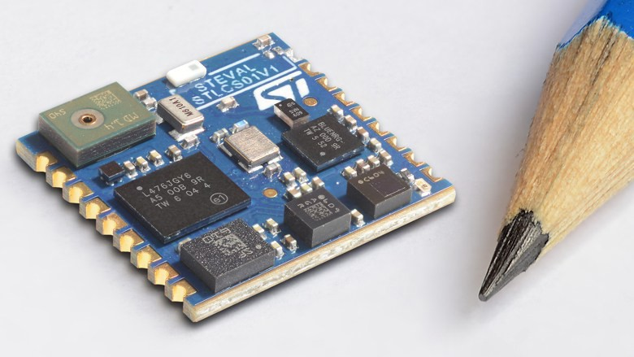
Low-end: STM SensorTile
80 MHz, single-core ARM-Cortex M4 CPU
192 kb RAM
1 Mbyte Flash
30 mW power consumption, 1uW in sleep mode
BLE
£25
Notes:
And so here’s an example of one of these low-end devices, namely an STM SensorTile. And this has an 80MHz, single-core ARM-Cortex M4 CPU, a tiny 192 kilobytes of RAM, and 1 megabyte of Flash memory, so there are strict limits on the types of computation it can perform. But on the plus side, it only draws 30 milliwatts of power, and can be put into a sleep mode in which it only draws a single microwatt. And in terms of communication, it uses BLE, a low-energy version of Bluetooth that allows it to use significantly less power than normal. And if you want to buy one of these, it will set you back around £25.

Slide 34
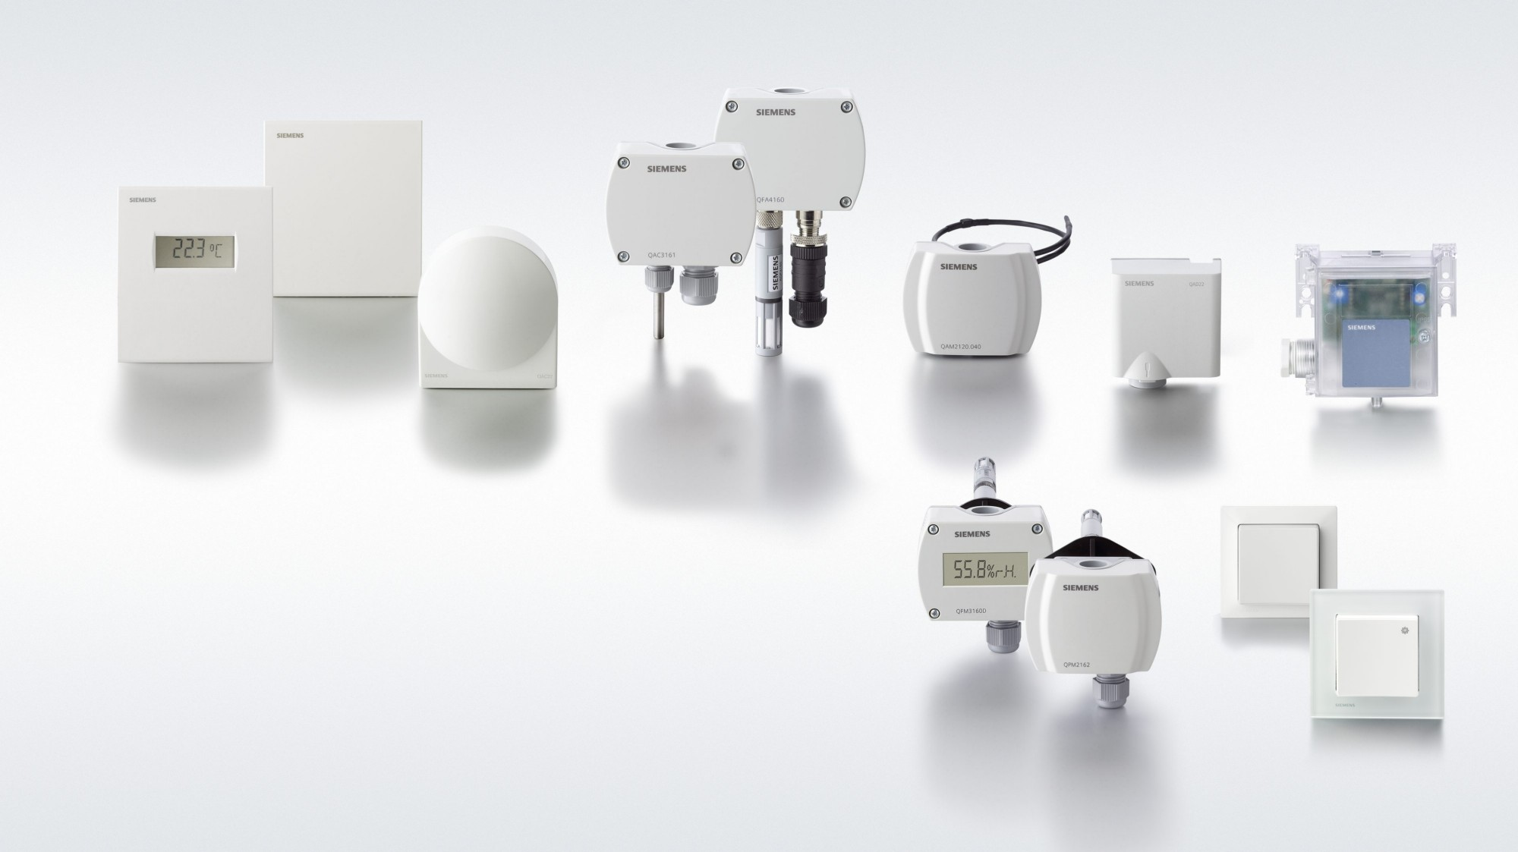
Nano-end
Battery-powered end devices
System-on-module
Typical power consumption in few mW
Embedded RTOS
Smoke alarms, HVAC sensors etc.
siemens.com
Notes:
Going even smaller, you have nano-end devices, which again are battery-powered end devices, in this case of the system-on-module variety. Again, they typically use only a few milliwatts of power, and run an embedded real-time operating system. And they’re commonly used for things like smoke alarms, as well as heating, ventilation and air conditioning sensors.

Slide 35
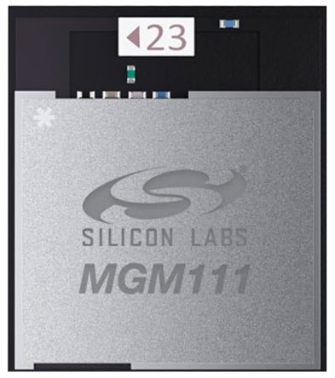
Nano-end: Silicon Labs MGM
40 MHz, single core ARM-Cortex M4 CPU
32 kB RAM
128 kB Flash
802.15.4 (Zigbee) Transceiver
£7
Notes:
So for example, this Silicon Labs MGM has a 40MHz, single-core ARM-Cortex M4 CPU, a minute 32 kilobytes of RAM, and only 128 kilobytes of Flash memory. And for communication, it uses a Zigbee transceiver, which is a low-cost, low-power transceiver targeted specifically at battery-powered IoT devices. And the whole thing is super-cheap at only £7.

Slide 36
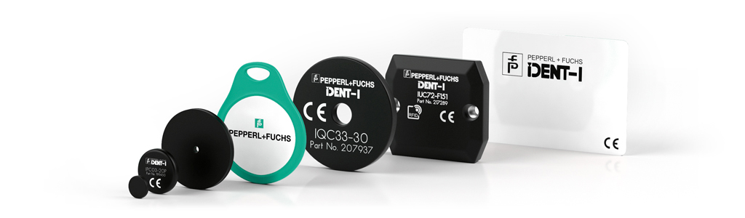
Pico-end
Battery-less, powered by RF backscatter
Mainly used for identification (e.g. RFID)
Some devices integrate sensors e.g. temperature
Highly optimized for extremely low cost
www.pepperl-fuchs.com
Notes:
Finally, at the very lowest level, you have pico-end devices, which are battery-less and powered by RF backscatter.
These are mainly used for identification, so for example RFIDs. But some devices also integrate tiny sensors, such as temperature sensors.
And the key design criterion at this level is that the devices should be as cheap as possible, so they’re highly optimized for extremely low cost.

Slide 37
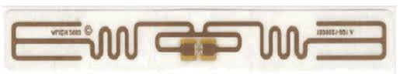
Pico-end: RFID EPC GEN2
10 m read distance
64 bytes of programmable memory
£0.05 unit cost
Notes:
And so here’s an RFID that has a 10m read distance, 64 bytes of programmable memory, and only costs around 5p.

Slide 38



Operating Systems for the IoT
The choice of operating systems depends on the computational power and available energy
Embedded Linux is a good fit for mains-powered devices
For resource-constrained devices, alternative RTOSes are needed:
FreeRTOS
ARM mbed OS
ContikiOS
RIOT
Notes:
So in general, you can see that the choice of operating system for a particular device depends fundamentally on the available computational power and energy.
So for example, Embedded Linux is a good fit for mains-powered devices, but for more resource-constrained devices, alternative real-time operating systems are needed, and you can see some concrete examples of those on the slide.

Slide 39
Anatomy of a Thing Sensors and Actuators
Notes:
Ok, so we’ve looked at the computational side of a thing, now let’s talk a bit about sensors and actuators.

Slide 40
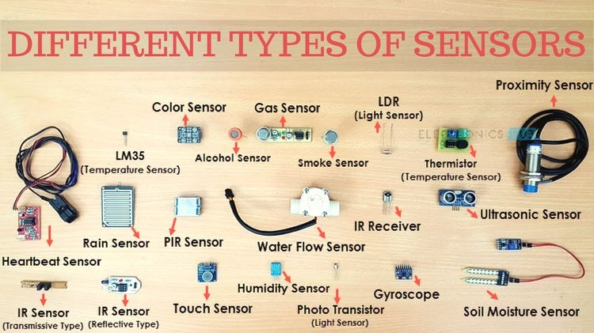
Sensors
Sensors convert real-world parameters to digital quantities
Interfaces (e.g., screens and buttons) do both
Huge variety of sensors:
Temperature
Light
Sound
Pressure
Acceleration
etc. etc. etc.
www.electronicshub.org
Notes:
So a sensor is basically anything that can convert real-world parameters to digital quantities.
And there are a huge variety of things we might want to sense, such as temperature, light, sound, pressure, acceleration, and so on, and a correspondingly huge variety of sensors that exist to achieve that.
Incidentally, note that certain interfaces, such as touch screens and physical buttons, can act as sensors, but can also separately act as actuators, which we’ll look at on the next slide.

Slide 41
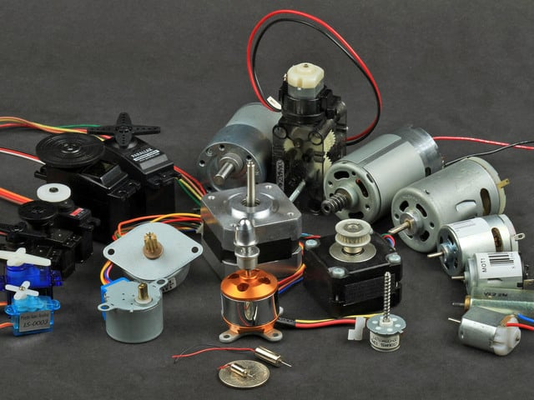
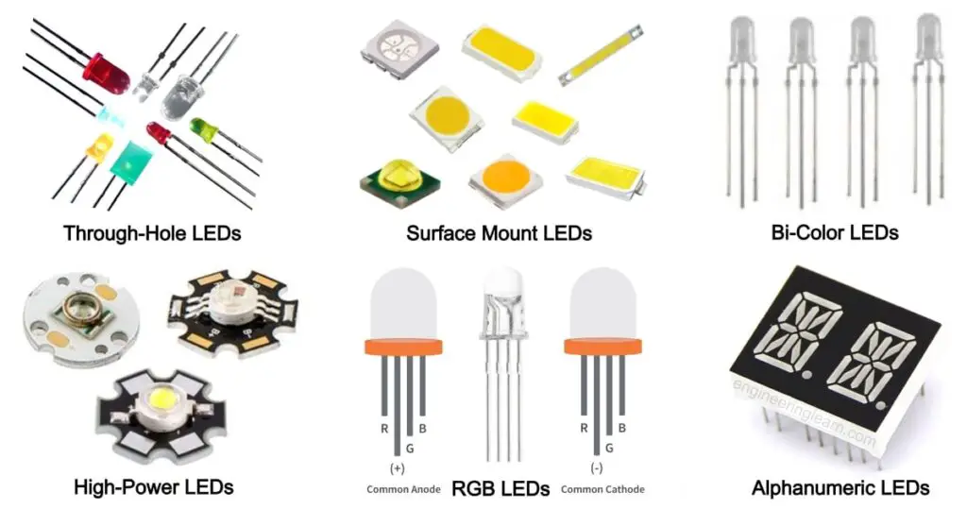
Actuators
Components that affect physical changes in the real world
Many types:
Motors
Lasers
LEDs
Display Screens
etc.
adafruit.com
engineeringlearn.com
Notes:
By contrast with a sensor, an actuator is any component that can effect a physical change in the real world.
And as with sensors, there are many different types of actuator, such as motors, lasers, LEDs, display screens, and so on.

Slide 42
Key parameters
Sampling rate, e.g. 100 Hz
Resolution, e.g. 10 bit
Power consumption, e.g. 1~mW
Size, e.g. 6 mm x 4 mm
Cost
Notes:
In practice, there are always trade-offs to be made when choosing sensors and actuators for a real-world system, and the choices are generally based on one or more key parameters of the devices.
And you can see some examples of parameters that might be relevant in this slide.

Slide 43
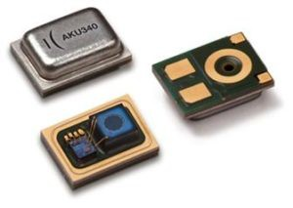
Example Sensor: MEMS microphone
Digital output
700µA when active
96 kHz maximum sampling rate
136 dB SPL maximum level
Notes:
And so here’s an example of a particular sensor, in this case a sound sensor called a MEMS microphone.
And so this one produces digital output, uses around 700 microamps of current when active, and has a maximum sampling rate of 96 kilohertz and a maximum sound pressure level of 136 decibels.

Slide 44
Anatomy of a Thing Power
Notes:
Ok, so we’ve looked at the computational side of a thing, now let’s talk a bit about sensors and actuators.

Slide 45
Energy
To perform any meaningful operation, energy is required
A pervasive IoT requires ubiquitous power
Energy is one of the key limitations that constrain the widespread deployment
Notes:
Well, to perform any meaningful operation on an IoT thing, you clearly need energy.
And thus for there to be a pervasive Internet of Things, there will need to be equally ubiquitous power.
So in practice, energy is one of the key limitations that constrains widespread IoT deployment as things stand.

Slide 46

Wires
If possible, get mains power
Perpetual computing without any of the fuss
A significant limitation on where devices can be placed
Notes:
So what are our options in terms of power?
Well, if you want to maximise the available energy, you can’t do any better than mains power, which gives you perpetual computing without any of the fuss.
But mains power clearly isn’t suitable for mobile devices, and even for static devices it’s not available everywhere, so if it’s an essential requirement then there are significant limits on where your device can be placed.

Slide 47
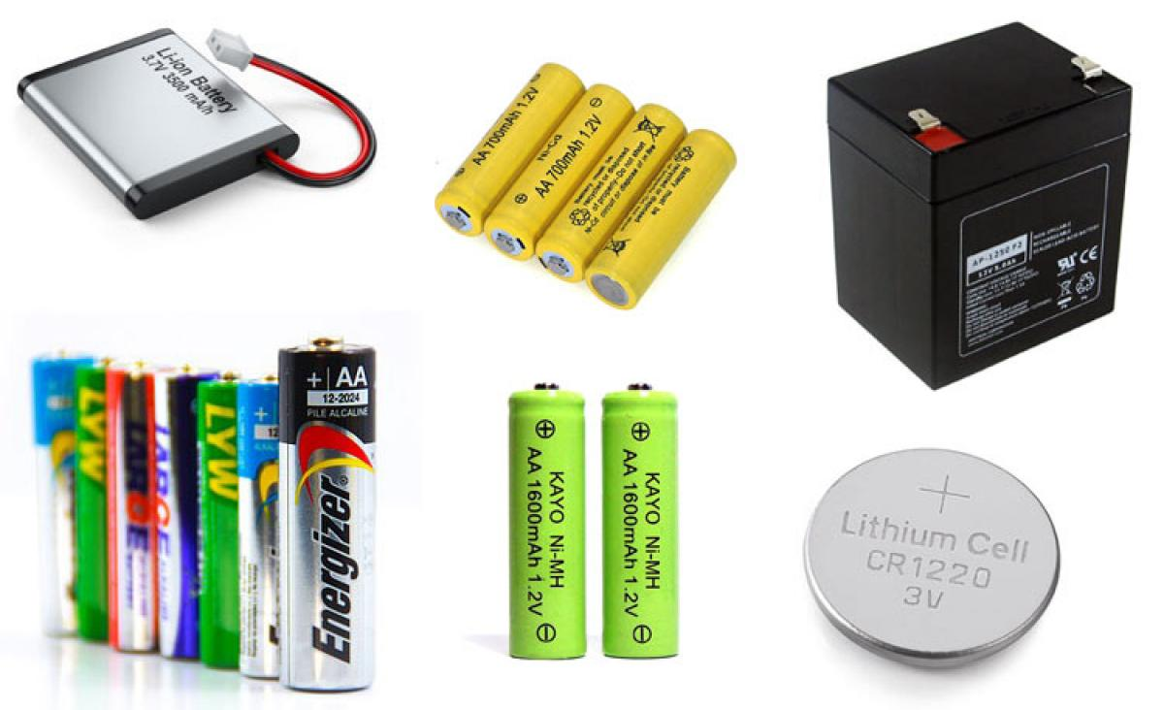
Batteries
Most common approach is to use a chemical battery
Primary battery has a high energy density, but cannot be recharged
Secondary batteries can be charged, but where does that energy come from?
components101.com
Notes:
So what if you’re in a situation where mains power isn’t viable?
Well, another option is obviously batteries, and most commonly chemical ones.
And these come in two main flavours, primary and secondary, where primary batteries are those that have a high energy density but cannot be recharged, whereas secondary batteries are rechargeable.
Even in the case of a rechargeable battery, though, it’s not always obvious where the energy should come from to recharge it.

Slide 48
Batteryless
In reality, many deployments are uncontrolled
Costs of running wires to each sensor are not feasible
Maintenance costs of changing batteries not sustainable
Environmental impact of (incorrectly) disposed chemical batteries is immense
Notes:
And this is a major issue in practice, because in reality, many deployments are uncontrolled, and it’s not practical to physically intervene in them all the time to recharge or replace the batteries. And even if we could somehow do that, disposing of all of the batteries correctly to avoid environmental damage would be prohibitively costly.
And it’s often similarly infeasible to run a wire to every single sensor, which rules out using the mains instead.
So what can we do?

Slide 49
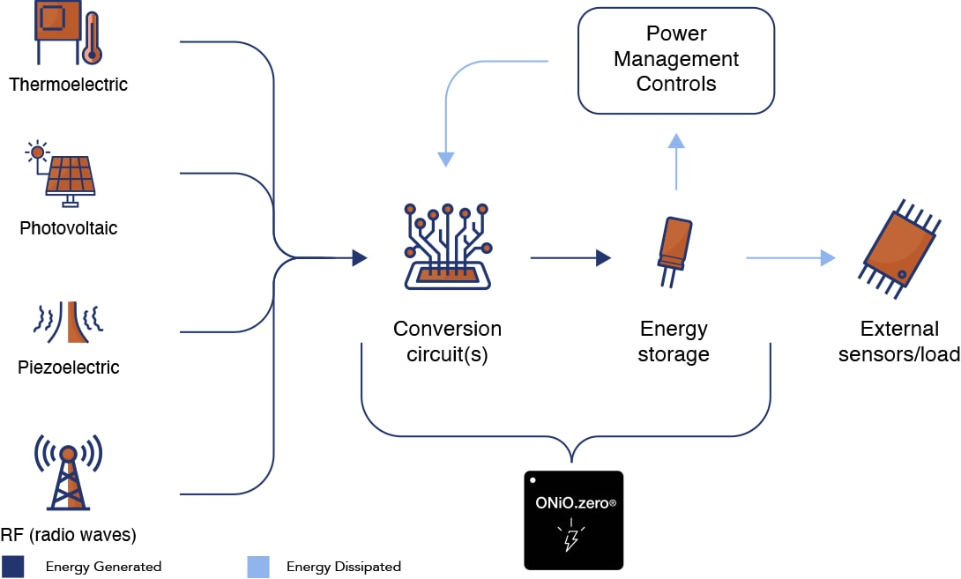
Ambient harvesting
Extract energy from ambient surroundings
Availability may be highly variable
Buffer energy in small battery or super-capacitor
Theoretical perpetual operation
www.onio.com
Notes:
Well, the alternative is to try to extract energy from your device’s ambient surroundings, in effect turning your device into a miniature power station.
And there are obviously lots of options for this, such as solar, wind, thermal and so on, but as ever with such sources, the availability may be highly variable.
And so in practice, you end up needing to buffer energy in a small battery or a super-capacitor, but if you do this, then it can work quite well, and theoretically allow for perpetual operation of the device.
So let’s now look at a few of the options in more detail.

Slide 50
Solar
Photo-voltaic cells convert radiant solar energy to electrical current
1000W/m² outside
Inside is much more challenging
Seasonal and diurnal variations
Significant levels of harvestable energy (watts)
Notes:
So for solar, you can use photo-voltaic cells to convert radiant solar energy to electrical current. And outside, this actually works pretty well, with an average return of 1000W per square metre of cells. Inside, though, it’s obviously much more challenging because you don’t get direct sunlight. And even outside, there are seasonal and diurnal variations that make the actual amount of power you can generate fluctuate over time. Nevertheless, when it’s viable, solar does allow you to generate significant levels of harvestable energy.

Slide 51
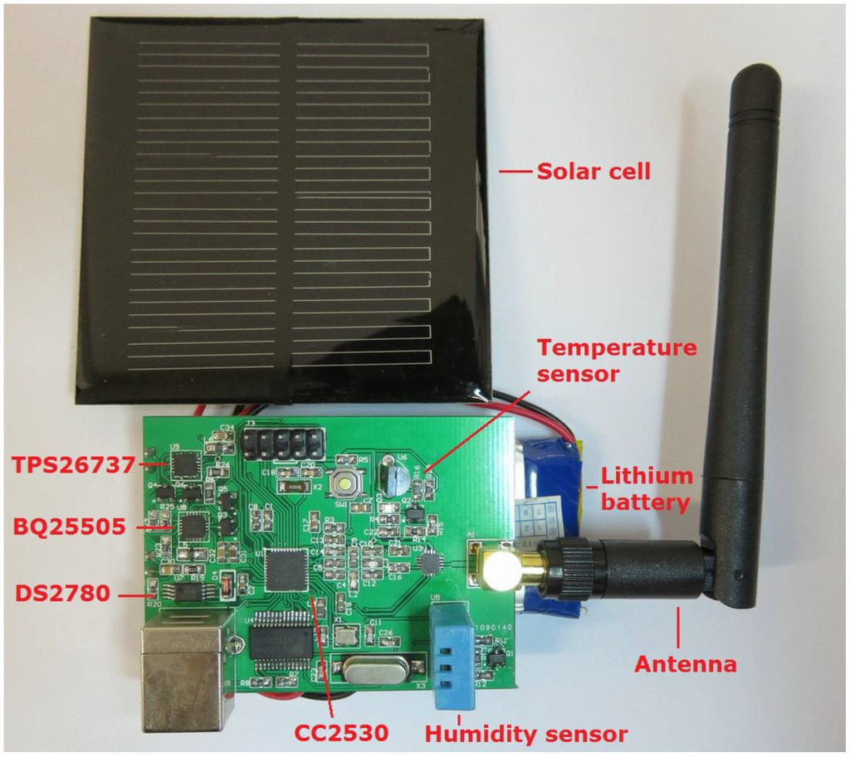
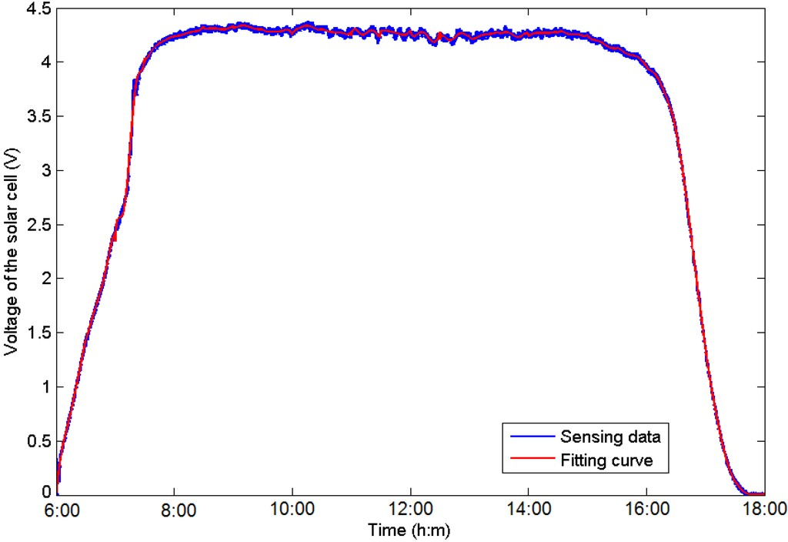
Solar
(a) Sensor Node (b) Forecasting
Figure 1: Predictive solar energy harvesting¹
¹Tengyue Zou et al. “Energy-efficient control with harvesting predictions for solar-powered wireless sensor networks”. In: Sensors 16.1 (2016), p. 53.
Notes:
And so here you can roughly see how the voltage you’re able to achieve varies over the course of a day. So basically it’s consistently pretty good when the sun’s out, doesn’t work at all when it’s not, and smoothly transitions between the two around dawn and dusk. Which is what you’d expect, really, because it’s based on your ability to see sunlight!

Slide 52
Vibration
Use resonant masses to extract energy from vibrations/impacts
Regular vibrations: e.g. air-conditioning duct
Irregular vibrations e.g. train or road bridge
Harvestable energy is small (milliwatts)
Notes:
So another way of harvesting energy is based on vibration. So here, the idea is to use resonant masses to extract energy from vibrations or impacts. And these vibrations can be regular, such as you might find in an air-conditioning duct, or irregular, such as you might find in a train or road bridge. In either case, the harvestable energy is in the milliwatt range, so pretty small, but that can be enough for certain types of device.

Slide 53
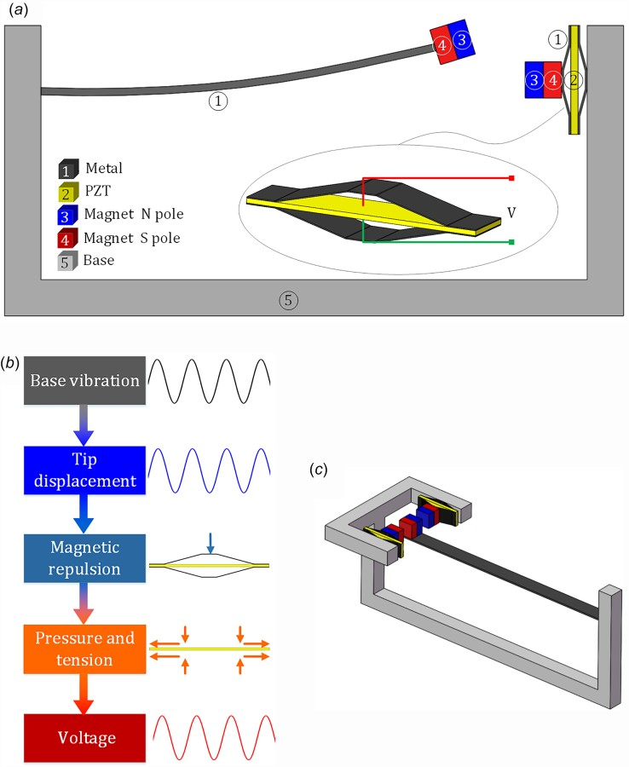
Vibration harvesting²
²Hong-Xiang Zou et al. “A compressive-mode wideband vibration energy harvester using a combination of bistable and flextensional mechanisms”. In: Journal of Applied
31
Notes:
And so here’s an example of a paper on vibration-based energy harvesting in case you want to find out a bit more.

Slide 54
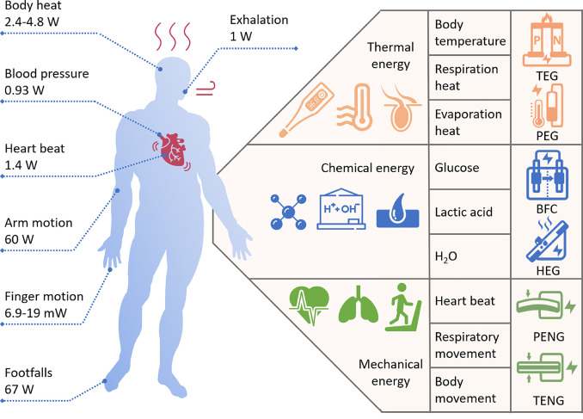
Thermal
Exploit thermal gradient e.g. between person and surroundings
Harvestable energy is very small (microwatts)
Can be boosted using thermal reservoirs to buffer thermal energy
Zou, Yang, Lin Bo, and Zhou Li. "Recent progress in human body energy harvesting for smart bioelectronic system." Fundamental Research 1.3 (2021): 364-382.
Notes:
So moving on, another type of ambient energy you can harvest is thermal energy, for example by exploiting the thermal gradient between a person and their surroundings.
In this case, the amount of energy you can harvest is in the microwatt range, so even smaller than with vibrations, but again, this has its uses.
And note that it can also be boosted by using thermal reservoirs to buffer thermal energy.

Slide 55
Radio: Rectennas
Harvest energy from radio broadcasts e.g. WiFi/TV broadcasts
Amounts of power are relatively small, but enough to power a low-power sensor node
Well suited to indoor and industrial applications
Challenge is tuning antenna to signals of opportunity
Notes:
So yet another type of energy that can be harvested is radio energy, for example from WiFi or TV broadcasts.
Again, the amount of power you can harvest in this way is relatively small, but it can be enough to power a low-power sensor node.
And it’s a technique that’s well suited to indoor and industrial applications.
The main challenge in this case is in tuning the antenna to signals of opportunity.

Slide 56
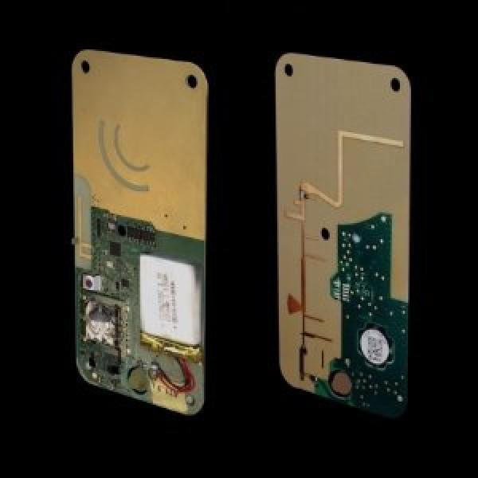
RFID Harvesting³
³http://www.getfreevolt.com/
Notes:
And so one application that can benefit from radio energy harvesting is smart bank cards, as you can see on this slide.

Slide 57
Radio: RFID
Canonical example of battery-less, passive tags
Extremely low-cost (<5p)
Only powered up when in range of a transmitter
Simultaneous communication and power transfer
e.g. UHF-GEN2
Notes:
It’s also useful for RFIDs, which are a canonical example of battery-less, passive tags.
These can be extremely low-cost at less than 5p a tag, only powering up when they’re in range of a transmitter, at which point the communication and the power transfer can happen simultaneously.

Slide 58
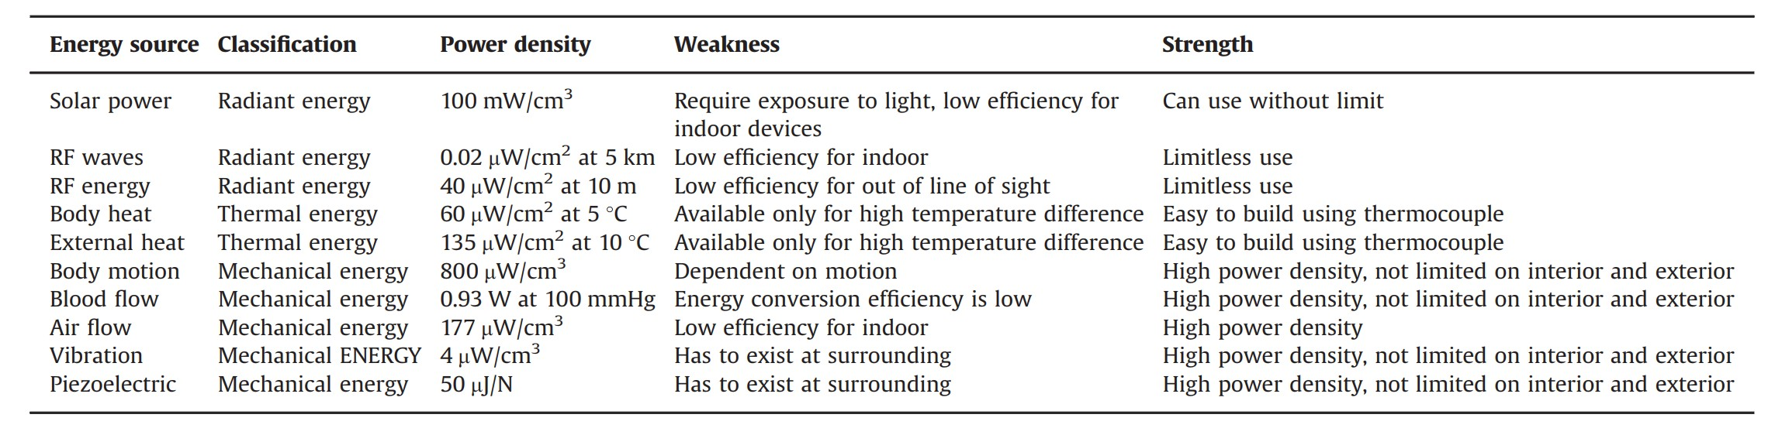
Comparison⁴
⁴ASM Zahid Kausar et al. “Energizing wireless sensor networks by energy harvesting systems: Scopes, challenges and approaches”. In: Renewable and Sustainable Energy Reviews 38 (2014), pp. 973–989.
Notes:
And so here’s an overall comparison of various different types of ambient energy harvesting, to help you to make a choice between them for a particular application.

Slide 59
Software implications
An assumption we make in conventional computing is perpetual power
But how do we modify these paradigms in the face of intermittent energy?
Transiently powered computation requires different primitives.
Notes:
So one thing we haven’t talked about so far is the potential implications of fluctuating energy availability on software.
So in conventional computing, this just isn’t an issue. We plug our computer into the mains, and we assume that there’s infinite power available.
But particularly when harvesting energy from the surroundings, it can clearly be a major issue that needs careful handling.
So what can we do?

Slide 60
Energy-aware operating systems
As power can be removed at any time, operations need to be atomic and rollback-able
State (a checkpoint) is stored in non-volatile memory
However, this costs energy, so a tradeoff needs to be made as to how often this is done
Notes:
Well, we need to write our programs to cope with the possibility of power being removed at any time, since that’s very likely. So that means that any important operations need to be atomic and easy to roll back.
And we’re also going to want to think about storing regular checkpoints in non-volatile memory, so that data isn’t lost when the power goes down. However, it’s worth noting that this costs energy, so there’s going to be a limit to how often we can do this, and we’re going to have to carefully manage that trade-off.

Slide 61
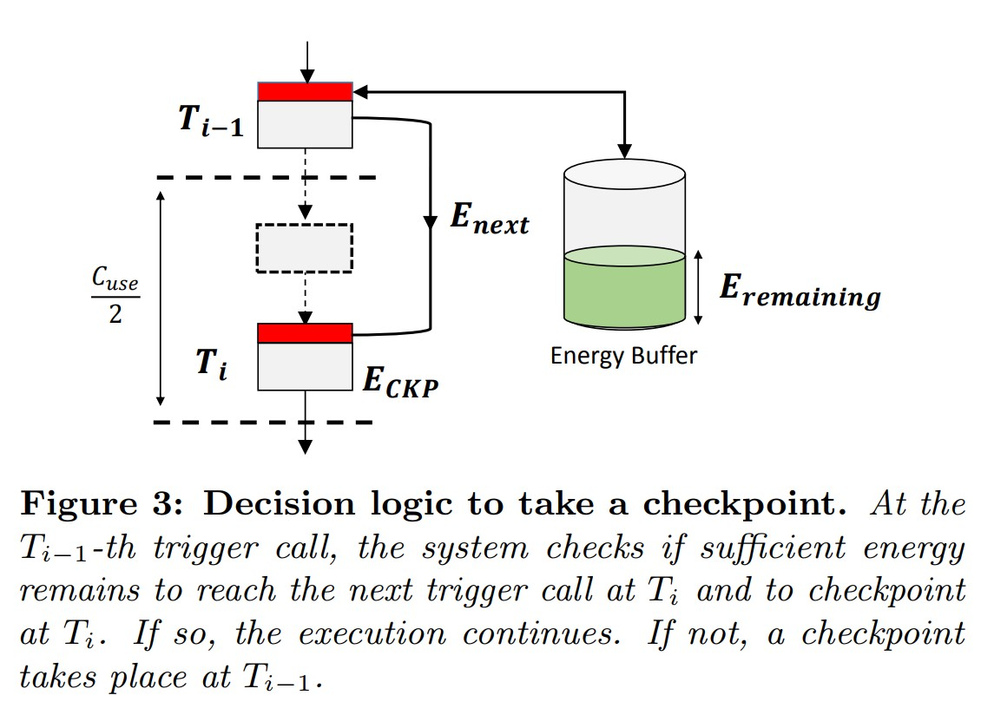
Example: HarvOS
HarvOS is an OS for transiently powered computation⁵
It heuristically decides how many cycles to run before checkpointing. When power is restored, the system carries on
from the last checkpoint
⁵Naveed Anwar Bhatti and Luca Mottola. “HarvOS: Efficient code instrumentation for transiently-powered embedded sensing”. In: Proceedings of the 16th ACM/IEEE International Conference on Information Processing in Sensor Networks. ACM. 2017, pp. 209–219.
39
Notes:
So in practice, there are also special operating systems for transiently powered computation, and you can see an example of that, known as HarvOS, in this slide.
And the way this works it that it heuristically decides how many cycles to run before checkpointing, and then restores the last checkpoint and carries on when power is restored.
So as ever, if you want more detail on that, please have a look through the paper.

Slide 62
Summary
No such thing as a “thing” in the Internet of Things
All things are different
Vast heterogeneity in terms of:
Connectivity (e.g. WiFi vs LoRA)
CPU (e.g. ARM A9 vs M0+)
Power (e.g. mains vs battery)
Cost (e.g. £100 vs £0.05)
Notes:
So in summary, having now looked at all of the key components that make up a thing, we can see that there’s vast heterogeneity between the different types of things we’re considering in practice, both in terms of their connectivity, their compute power, their sources of energy, and their cost.

Slide 63
Further Reading
Pouya Kamalinejad et al. “Wireless energy harvesting for the Internet of Things”. In: IEEE Communications Magazine 53.6 (2015), pp. 102–108
Oliver Hahm et al. “Operating systems for low-end devices in the internet of things: a survey”. In: IEEE Internet of Things Journal 3.5 (2016), pp. 720–734
Tolga Soyata, Lucian Copeland, and Wendi Heinzelman. “RF energy harvesting for embedded systems: A survey of tradeoffs and methodology”. In: IEEE Circuits and Systems Magazine 16.1 (2016), pp. 22–57
Notes:
And if you want further reading on any of this, there are some references in this slide.

